Slide 1
Privacy protected Remote medical system
David’s team of aws-hackathon-2020
https://pages.segmentfault.com/aws-hackathon-2020

Slide 2
Background story
Due to the covid 2019, the remote medical service become a crucial part of the medical system
Usually because:
The unbalance medical resource distribution
The outbreak drain the medical resource so fast
Now the occasional infected became a new normal:
Remote medical service also become a habit
Remote medical service is convent and cost effective
Remote medical service decrease the risk of exposure

Slide 3
Pain points
Information disadvantage
Time costing disadvantage
limited access for physical examination such as lung auscultation, abdomen Palpitation.
Remote communication usually cause confusion, in accurate and misleading symptom description. explanation graphically or demonstration will be difficult conducted through tele consultation
Medical history hard to acquire across region
personal data protection can be breached if no secure platform
time cost will be increased due to tele consultation
Illustration of pain cost too much time
patient will spend more time to express clearly compared to real time. same as doctor will take much longer to explain to patient about medical diagnosis, treatment and future follow up.

Slide 4
Business solution
3 Steps:
1 Chatbot AI pre-diagnose---reduce time , provide accurate description of the pain
2 diagnose dashboard support with real-time health metrics and historical medical data----provide real-time, accurate feedback
3 Chatbot follow-up with post-diagnose including medicine intake and BP , Heart rate monitor------personal care with personalized service

Slide 5
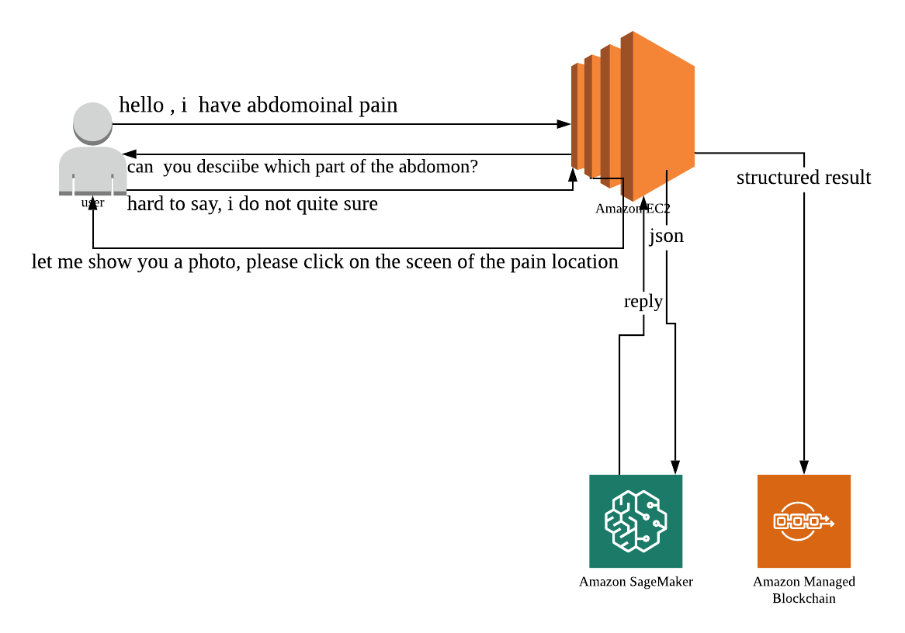
Step 1 pre-diagnose with Chatbot

Slide 6


Step 2 dashboard augmented HCP engagement data flow—more data less time wasted
subject | Patient history data | Pre-diagnose data | Real-time metrics data | AI-supplemental prediction data
Doctor
Patient

Slide 7
Step 3 alexia voice service follow up
Prescription
Reminder of medicine intake

Slide 8
Tech solution
Chatbot use NLP with sagemaker jupyter notebook
Blockchain for patient medical history privacy protection
IOT data ingestion from BP and heartrate monitor and other devices
Anomy detection for BP and heart-rate monitor
Dashboard for display

Slide 9
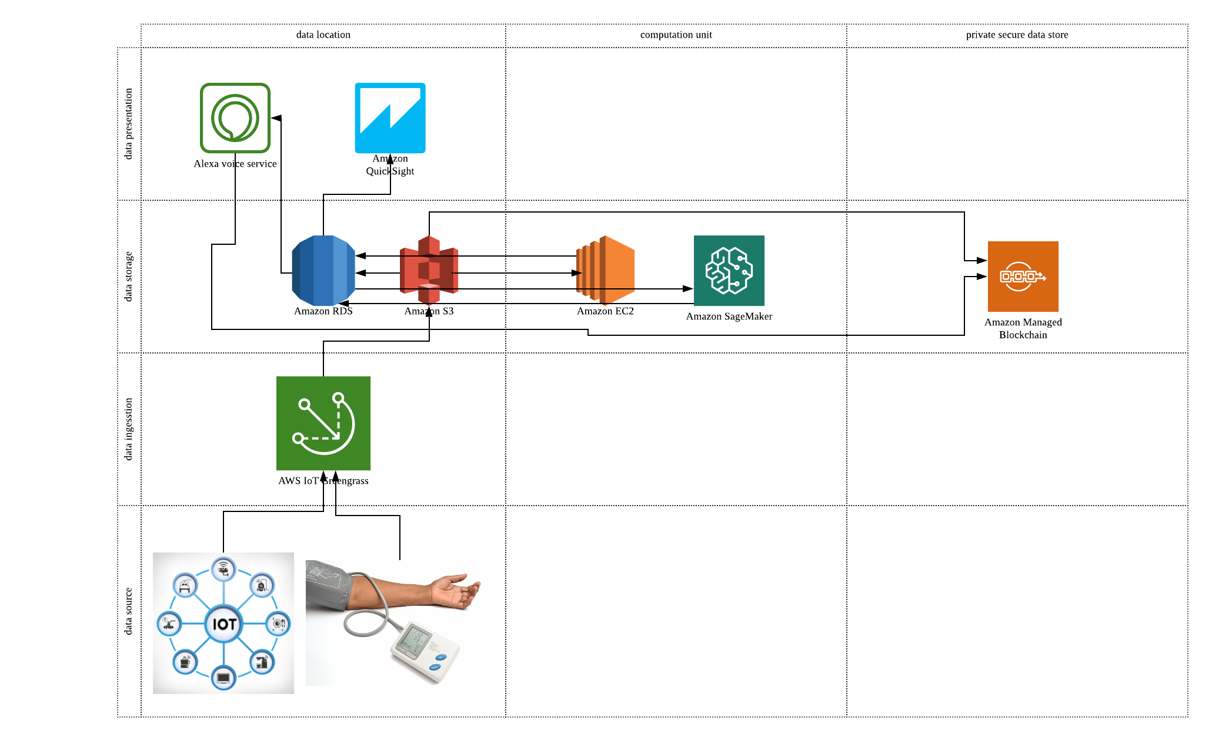

Slide 10
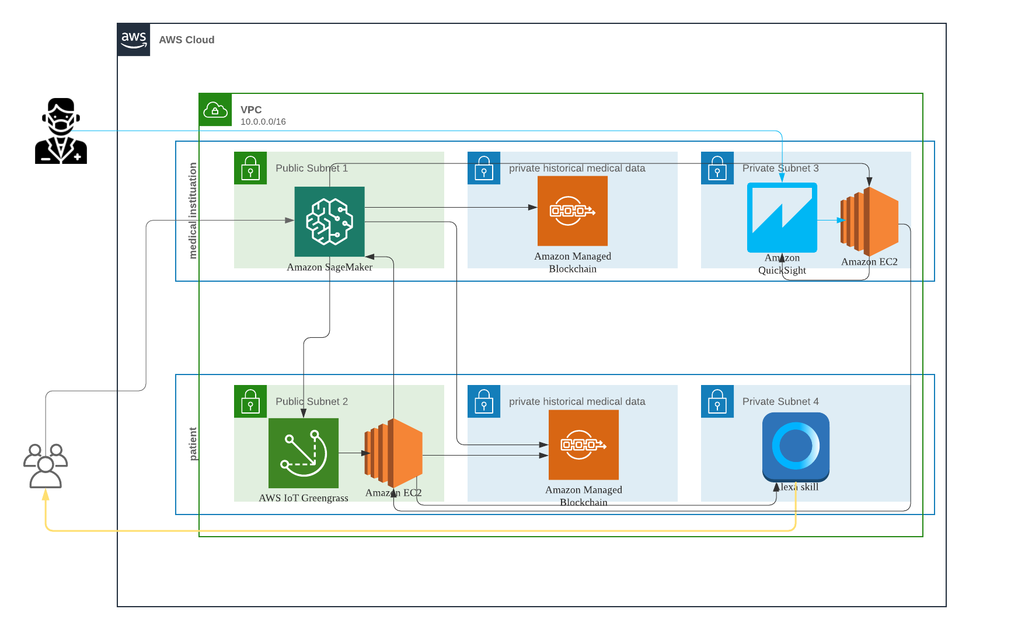
Architecture diagram
Black line: patient data
Blue line: doctor data
Yellow line: alexia data

Slide 11
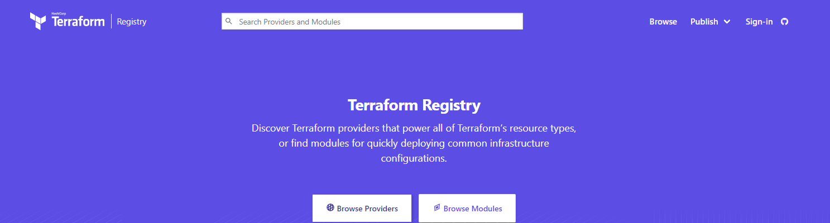
Most importantly--- how to deploy
Terraform will be our ultimate solution to persist our contribution to the world.
One click deployment

Slide 12
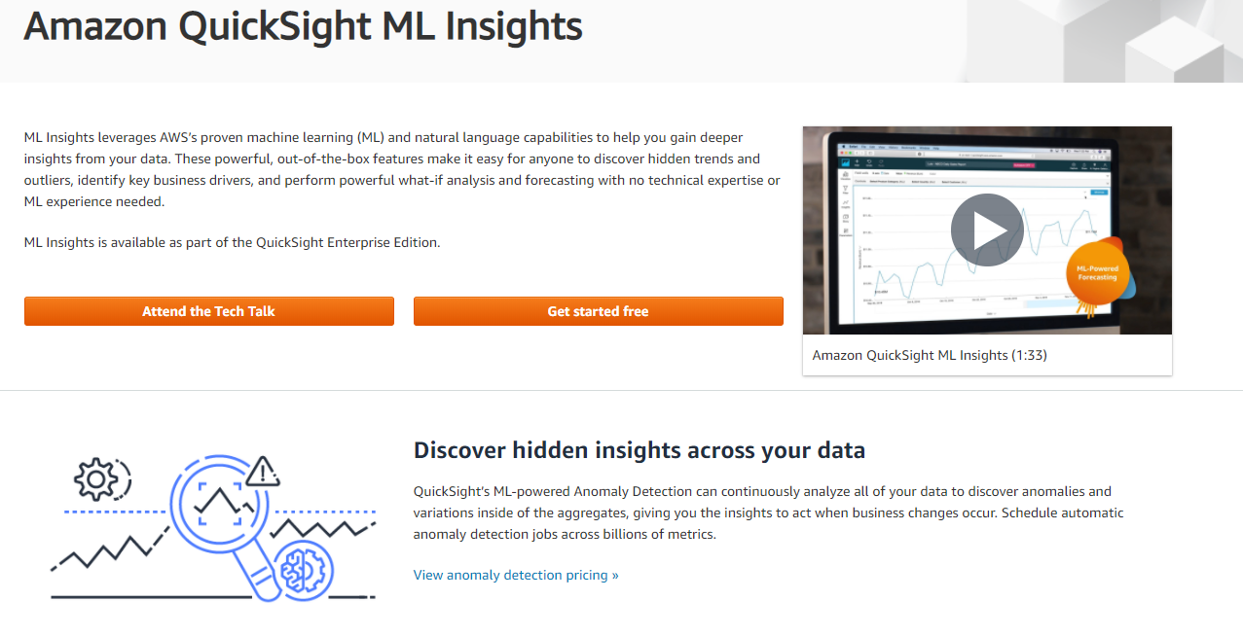
Awesome ML BI feature of aws quicksight

Slide 13
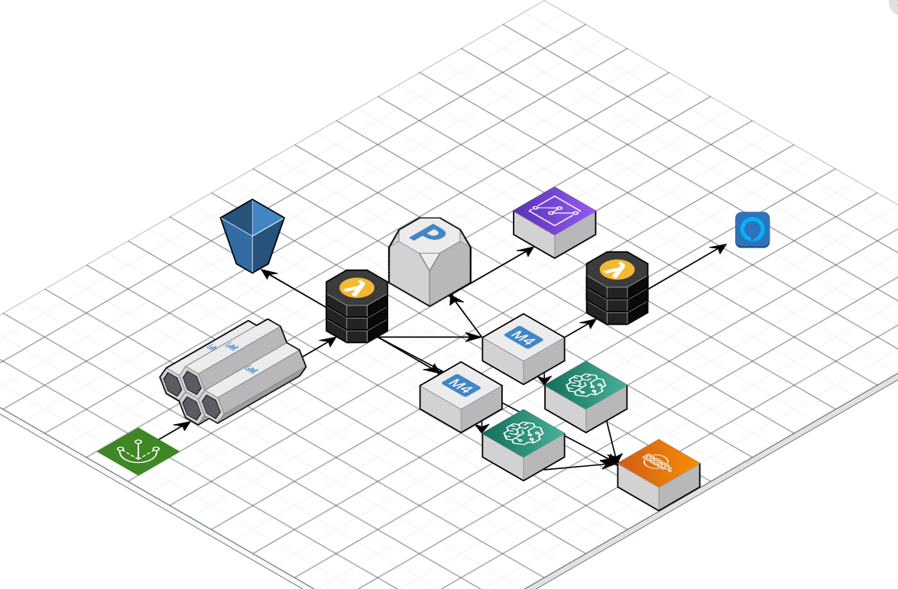
Aws implementation architecture map

